Slide 1
Michigan Surgical Quality Collaborative:
SUCCESS Performance Improvement Project
Project Kick-off Video
January 2024
Enhancing Urinary Catheter Appropriateness and Safety
for Adult Surgical Patients:
Beyond Catheter-Associated Urinary Tract Infection (CAUTI) Prevention

Slide 2

Evidence and support of this project provided by the:
Michigan Surgical Quality Collaborative (MSQC) in partnership with the
Surgical Urinary Catheter Care Enhancement Safety Study (SUCCESS)
This work was supported by the Agency for Healthcare Research and Quality (AHRQ) grant number 1R01HS026912 and Blue Cross Blue Shield of Michigan (BCBSM).

Slide 3
Purpose of this presentation:
Explain why urinary catheter safety needs to be a priority now.
Discuss the data from MSQC about catheter safety and appropriateness.
Introduce SUCCESS toolkit items for reducing unnecessary catheter use, optimize catheter insertion safety, and improve the patient experience.
Notes:
With so many demands at this time (COVID, Short-staffing, supply chain), we would like to explain why this project is important for our adult surgical patients – both ambulatory and inpatient- now.
HAI rates are increasing with COVID
Supporting documents:
The Impact of Coronavirus Disease 2019 (COVID-19) on Healthcare-Associated Infections - PubMed (nih.gov)
Continued Increases in HAI Incidence During the Second Year of the COVID-19 Pandemic | Infection Control & Hospital Epidemiology | Cambridge Core
Patients with noninfectious catheter complications such as POUR and urethral injury will further strain bed capacity. This is especially true for ambulatory surgeries that may require inpatient beds. Increased beds = increased nursing staff.
Emerging fungal infections- resistant to traditional fungal treatments are also a threat.
Discuss the data - This will go over specific data of how our hospital is doing compared to other Michigan hospitals in terms of catheter appropriateness and safety (not only CAUTI). [NOTE: If this information is not available, then MSQC can supply a similar hospital data as a proxy for incidence/rates]
Provide strategies for how we can enhance catheter care and safety
Finally, we would like to request your support.

Slide 4
Why urinary catheter safety needs to be a priority now

Slide 5
Bottom line:
Urinary catheter-associated injury is not minor or rare
Urinary catheter-associated complications and urethral injuries are preventable and costly
Safer and more appropriate urinary catheter use can occur with the implementation of low-cost evidenced-based strategies to:
  Avoid unnecessary catheterization
  Standardize management of post-operative urinary retention (POUR)
  Ensure safer insertion

Slide 6


Meet Mr. Hurt and Mr. Fine: Identical Patients at Two Different Hospitals
Mr. Hurt
Mr. Fine
Both procedures are surgically successful, but this is where the similarities end…
Age: 64
Comorbidities: Benign prostatic hyperplasia (BPH)
Surgery: Laparoscopic Cholecystectomy for Symptomatic Gallbladder Stones
No intraoperative complications
Identical anesthetic agents
No hospital-acquired complications apparent in billing codes and discharge diagnoses
Same cost/same insurance reimbursement
Notes:
The best method to illustrate the significance of catheter safety and appropriateness is with a case study.

Slide 7
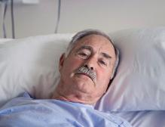


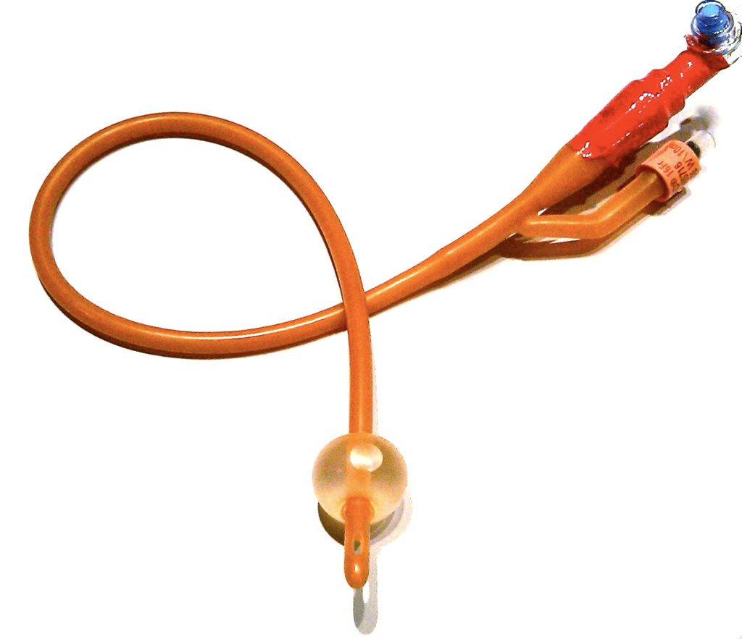
Mr. Fine
Indwelling foley catheter removed at the end of the case.
Urethra required healing so foley reinserted under cystoscope by Urology. Increased LOS by 2 days. Discharged home with catheter.
Mr. Hurt
Experienced postoperative urinary retention (POUR). Treated in accordance with protocol. Straight catheter x1
Experienced postoperative urinary retention (POUR). No protocol for management. Suffered genitourinary injury from straight catheter attempts x4.
Discharged home with no catheter needs. Recovery went smoothly.
Returned to ED for CAUTI, started on antibiotics. Then, readmitted within 30 days for increased pain due to urethral stricture from catheterization.
Decreased patient anxiety and discomfort • Increased patient satisfaction • Decreased additional invasive procedures• Returned to work as planned
Increased patient anxiety and discomfort • Decreased patient satisfaction • Increased invasive procedures • Increased avoidable Urology consults • Out of work for an additional 6 weeks
Notes:
NOTE: WHen presenting this slide emphasize the (1) inappropriate catheter placement for surgery (2) urethral trauma on repeated catheter attempts (3) Unstandardized treatment of POUR (4) Poor outcomes (5) Patient distress!

Slide 8
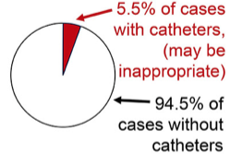

What do we know about Catheter Appropriateness ?
Background
MSQC Data
We used MSQC data to study how often catheters were used for specific procedures for which catheter use was deemed inappropriate by experts (De Roo et al, Am J Surg, 2020)
Surgical patients, for whom catheter placement has traditionally been routine, are candidates to be evaluated for more appropriate use.
13,032 procedures: 721 (5.5%) of cases used a catheter, although rates varied by procedure:
  3.1% laparoscopic cholecystectomy
  8.9% laparoscopic appendectomy
  26.9% open appendectomy
Notes:
The first step to increase safe catheter care and reduce the cascade of preventable complications, is to reduce the use of catheters outright. Surgical patients, who routinely have catheters placed during surgery are candidates to be evaluated for more appropriate use. Surgical patients, who routinely have catheters placed during surgery are candidates to be evaluated for more appropriate use. Approximately 5.5 % of surgeries have the potential to reduce use ( full reference below)
Using appropriateness criteria to identify opportunities to improve perioperative urinary catheter use. Am J Surg. 2020
https://pubmed.ncbi.nlm.nih.gov/32008720/

Slide 9

What do we know about Catheter Complications & Injury?
Background
MSQC Data: Serious Catheter Injury
Unlike CAUTI, noninfectious catheter complications are not routinely measured or reported, despite being an invasive procedure
Infections and trauma/injury related to catheters are common, but the rates reported vary markedly by data source.
Catheter Complications: The incidence of noninfectious complications, such as pain or blood in the urine, can rival or surpass that of CAUTI and impacts patients’ quality of care. One study found 55% of patients reported non-infectious complications of urinary catheters (Saint et al, JAMA Intern Med, 2018)
Catheter Injury/Trauma: Traumatic injury to the urethra during catheter placement or removal can be as high as $300k per injury (Davis et al, J Urol, 2016)
Pilot data collection
N= 786 patients
14 MSQC hospitals
Of the 200 patients with a new indwelling catheter, 4
(2 in 100)
were coded as having a serious urinary catheter trauma/injury (does not include minor complications such as pain or discomfort)
Notes:
Bullet #1 - read and add - Infectious urinary catheter complications such as symptomatic CAUTI, CAUTI-associated bloodstream infection, and asymptomatic bacteriuria outcome are routinely collected by standardized medical record review for mandated public reporting and used in multiple Medicare programs to compare hospital performance and financially penalize hospitals. Unfortunately, noninfectious catheter complications from traumatic injury to the urethra during catheter placement or removal are not routinely measured or reported despite being an invasive procedure.
Bullet #2 - Read and add – data collected from patient patient interview demonstrate much higher rates of complications than rates to billed or documented events. Rates in billed and documented events capture the most serious events like those requiring more surgery.
Bullet #3 - Read. [Full reference below]
Multicenter Study of Patient-Reported Infectious and Noninfectious Complications Associated With Indwelling Urethral Catheters. JAMA Intern Med. 2018 Aug.
https://pubmed.ncbi.nlm.nih.gov/29971436/
Bullet #4 - Read [ Full reference below]
Incidence, Cost, Complications and Clinical Outcomes of Iatrogenic Urethral Catheterization Injuries: A Prospective Multi-Institutional Study. J Urol. 2016
https://pubmed.ncbi.nlm.nih.gov/27317985/
MSQC Pilot Study data
Note: Pilot data includes these surgical categories :
Surgical Categories: Appendectomy, Cholecystectomy, Colorectal, Inguinal, femoral and ventral hernia

Slide 10


What do we know about Postoperative Urinary Retention (POUR) ?
Background
MSQC Data: Significant POUR
POUR is a common complication of surgical procedures and one of the main reasons patients are catheterized postoperatively
POUR can be traced to preventable patient morbidity such as UTI, sepsis and urethral trauma
POUR is attributed to adverse hospital-level outcomes
Avoiding POUR is important to realize full benefit of value-based purchasing
Pilot data collection
N= 786 patients
14 MSQC hospitals.
Of the 746 patients without exclusion criteria and no noted chronic catheterization, 32 (4.3 in 100)
were coded as having significant urinary retention within 30 days of the procedure
Notes:
Another important step to reduce catheter-related complications is to improve the treatment of postoperative urinary retention (POUR), a common complication of inpatient and outpatient surgical procedures. POUR is the inability to urinate after a surgical procedure despite having a full bladder and it is one of the main reasons why patients are catheterized postoperatively.
Bullet #1 - Read
Bullet #2- Although once considered a minor complication, POUR can be traced to preventable patient morbidity such as UTI, sepsis and urethral trauma.
Bullet #3- Additionally, POUR is attributed to adverse hospital-level outcomes
Bullet #4 - [Consider repeating the information below]
Patients with POUR will further strain bed capacity. This is especially true for ambulatory surgeries that may require unplanned inpatient beds.
MSQC Pilot Study data
Note: Pilot data includes these surgical categories :
Surgical Categories: Appendectomy, Cholecystectomy, Colorectal, Inguinal, femoral and ventral hernia

Slide 11
2023 SUCCESS Data
 | SUCCESS sites | Collaborative wide
Cases completed Category A: Avoid Placement Category B: Remove in OR Category C: Remove POD 1-2 | 5,249 (3746 Category A, 1399 Category B, 104 Category C) | 14,035 with catheter use/retention data (9784 Category A, 3901 Category B, 350 Category C)
Postop retention rate | 1.4% (Range 0-6.3%) | 1.1% (Range 0-6.9%)
Average category A catheter use (lower better) | 12.4% (0-70%) | 31.4% (0-81%)
Average category B catheter d/c in OR (higher better) | 46.2% (0-93%) | 44.1% (0-89%)
Notes:
Still more room for improvement, collaborative sites not as good as SUCCESS sites yet

Slide 12

Mr. Fine
Indwelling foley catheter removed at the end of the case.
Urethra required healing so foley reinserted under cystoscope by Urology. Increased LOS by 2 days. Discharged home with catheter.
Mr. Hurt
GOAL #1
Avoid Unnecessary Catheterization
Experienced postoperative urinary retention (POUR). Treated in accordance with protocol. Straight catheter x1
Experienced postoperative urinary retention (POUR). No protocol for management. Suffered genitourinary injury from straight catheter attempts x4.
GOAL #2
Standardized Management of POUR
Discharged home with no catheter needs. Recovery went smoothly.
Returned to ED for CAUTI, started on antibiotics. Then, readmitted within 30 days for increased pain due to urethral stricture from catheterization.
Decreased patient anxiety and discomfort • Increased patient satisfaction • Decreased additional invasive procedures• Returned to work as planned
GOAL #3
Ensure Safer Insertion
Increased patient anxiety and discomfort • Decreased patient satisfaction • Increased invasive procedures • Increased avoidable Urology consults • Out of work for an additional 6 weeks
Notes:
NOTE: WHen presenting this slide emphasize the (1) inappropriate catheter placement for surgery (2) urethral trauma on repeated catheter attempts (3) Unstandardized treatment of POUR (4) Poor outcomes (5) Patient distress!

Slide 13
How we can reduce unnecessary catheter use, optimize catheter insertion safety and improve the patient experience?

Slide 14
Strategies to enhance catheter appropriateness and safety:
Goal #1
Avoid unnecessary catheterization
Decrease use of unnecessary catheters during surgery
Goal #2
Standardize management of POUR
Implement standardized management of POUR
Ensure necessary equipment and resources (Scanners, Coude)
Goal #3
Ensure safer insertion
Increase refresher and new employee training for safer catheter insertion
Ensure necessary equipment and resources (Difficult Catheter Care kit)
Collect, analyze and report measures routinely
Notes:
[Below is a summary of the bullets]
Decrease use of unnecessary catheters during surgery
And if you do have to use a catheter, ensure the highest standards of safety and efficiency – to reduce discomfort and distress to the patient.
Standardized management of POUR
Ensure necessary equipment and resources
Increase refresher and new employee training for catheter insertion
Collect, analyze and report measures routinely

Slide 15

MSQC SUCCESS Key Toolkit Components
GOAL #1
Avoid Unnecessary Catheterization
Perioperative Urinary Catheter Use Guide (MAP Poster)
Urinary Retention and Safe Catheter Insertion Algorithm
Algorithm for Voiding Trials – NEW!
10 Practical Tips for Safe Urinary Catheter Insertion Booklet
Coude Catheter insertion Video
Visit the SUCCESS webpage to
view the full SUCCESS toolkit!
GOAL #2
Standardized Management of POUR
GOAL #3
Ensure Safer Insertion

Slide 16
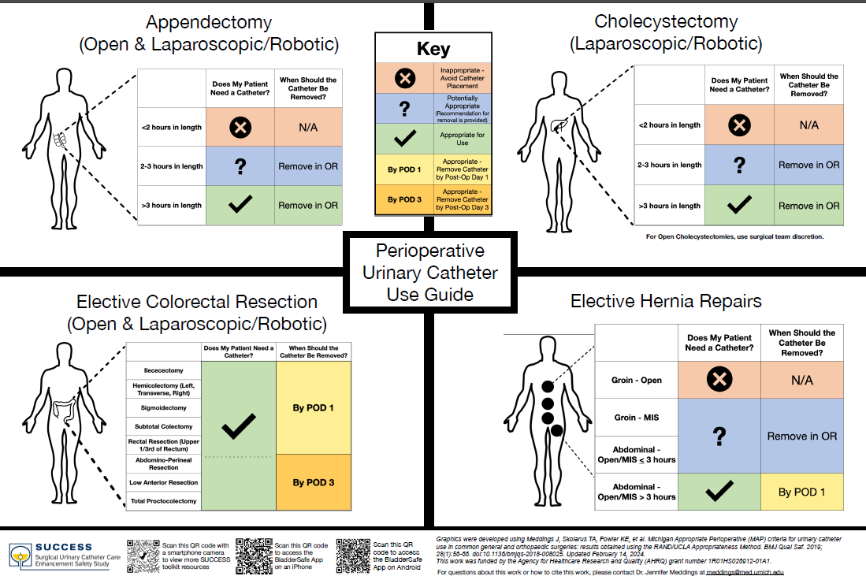
Perioperative Urinary Catheter Use Guide (MAP Poster)

Slide 17
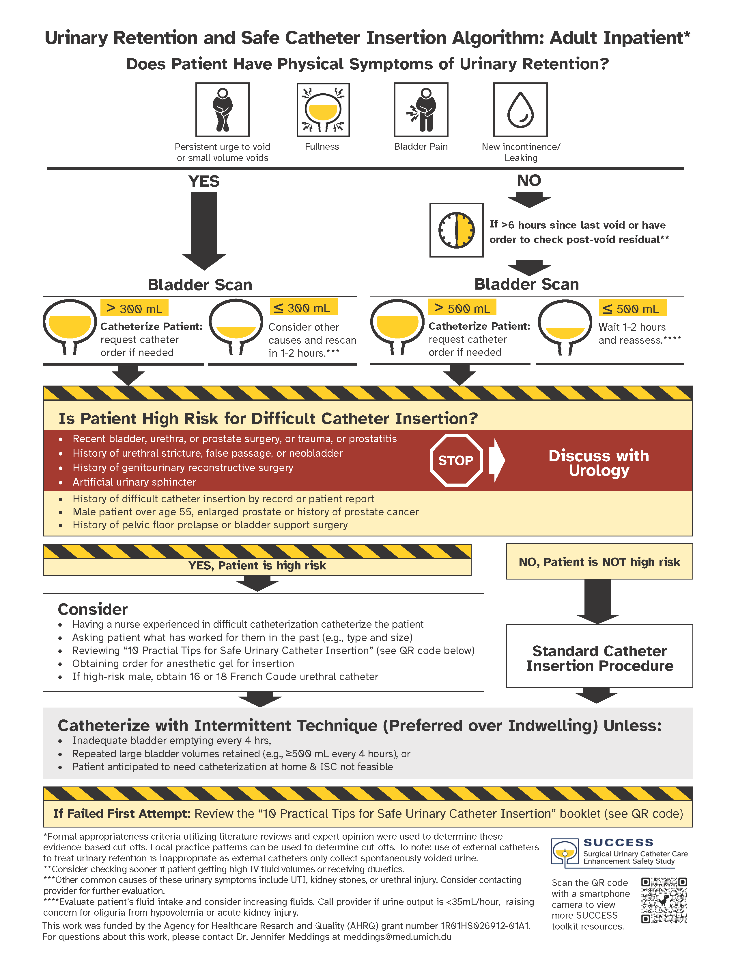
Urinary Retention and Safe Catheter Insertion Algorithm

Slide 18
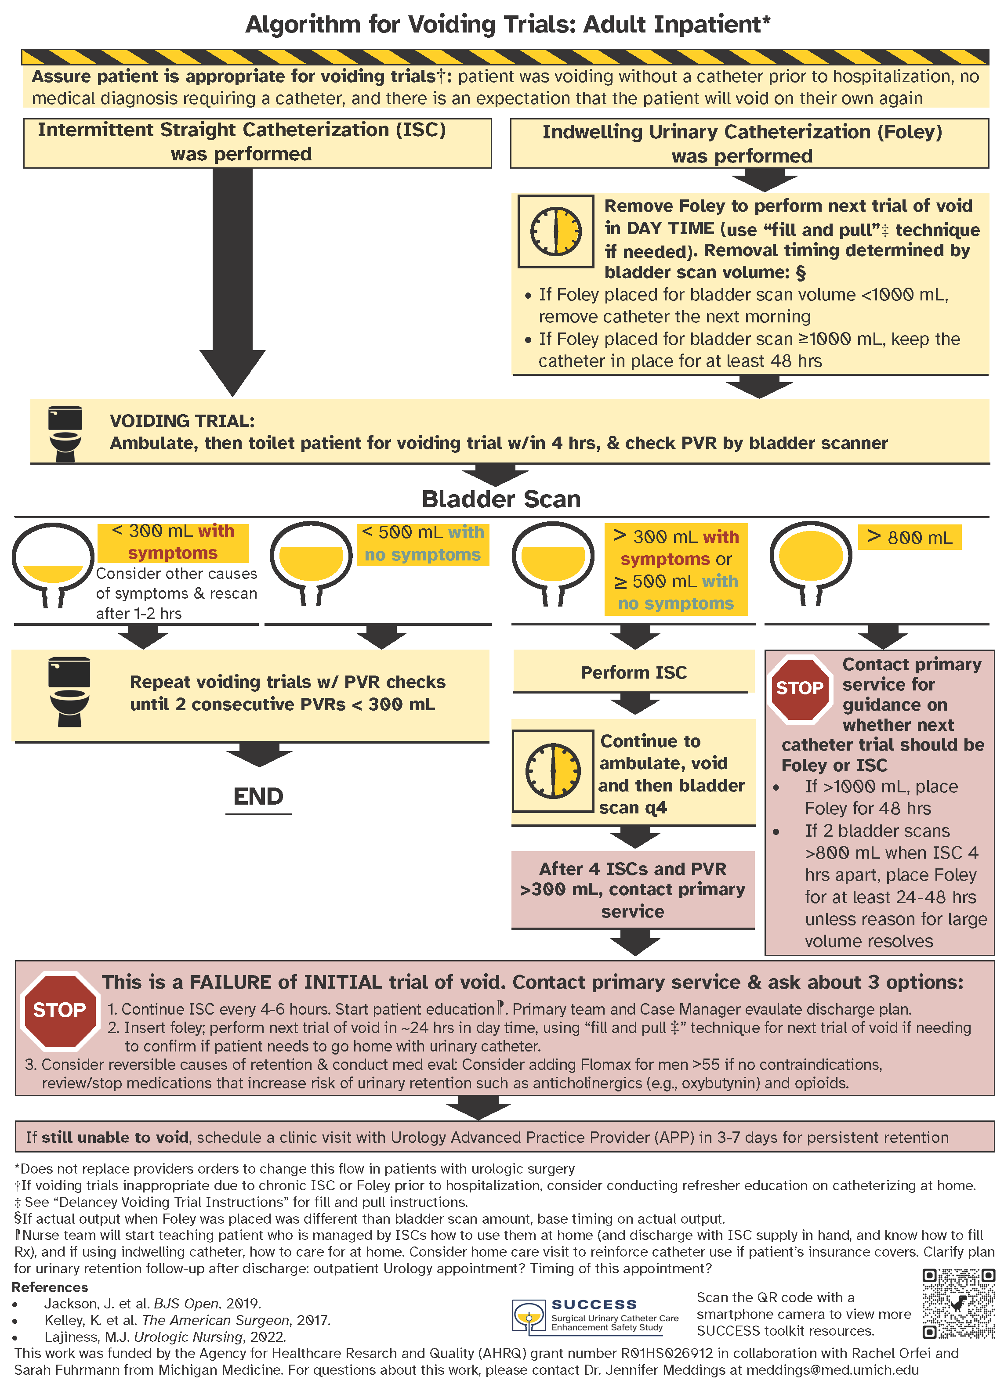
Algorithm for
Voiding Trials

Slide 19
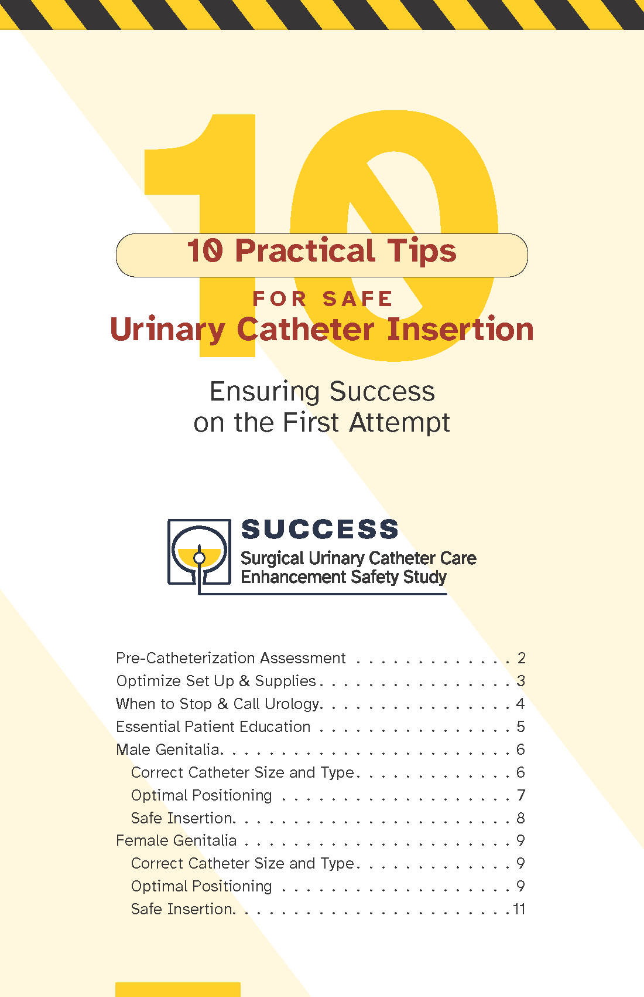
10 Practical Tips for Safe Urinary Catheter Insertion Booklet

Slide 20


Coude Catheter insertion Video

Slide 21
Implementing the SUCCESS Project
Resources for your SUCCESS kick-off meeting:
Kick-off meeting agenda template
SUCCESS kick-off video
Other Implementation Resources:
One-pager SUCCESS flyer with QR codes and screenshots of the tools
Guide to Patient Safety (GPS) self-assessment tool
Notes:
..

Slide 22
Implementing the SUCCESS Project cont.
Tips:
Redeployment of bladder scanners and Coude catheters to areas of highest need
Implementation of a Difficult Catheter Care Kit to targeted units
Catheter blitz to introduce toolkit
Monthly stakeholder meeting
Introduce project to ED
Hang posters in surgical rooms
Keep Urinary Retention and Safe Catheter Insertion Algorithm and 10 Practical Tips for Safe Urinary Catheter Insertion Booklet at nurse stations
Share your data:
Distribute your SUCCESS data to your leaders and frontline clinicians
Notes:
..

Slide 23
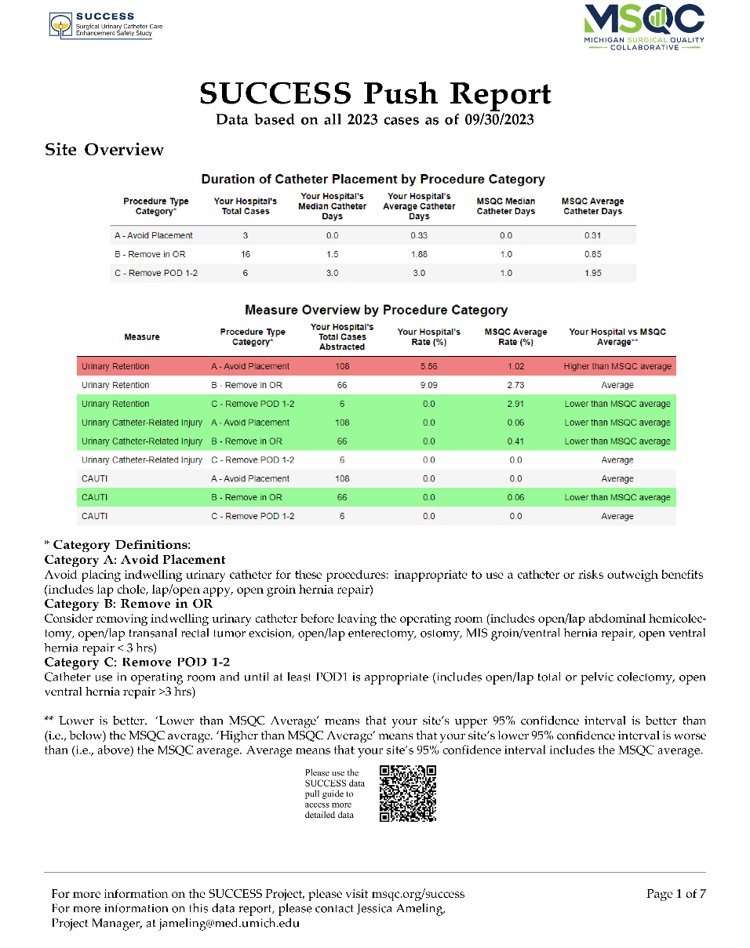
SUCCESS Data Feedback Report

Slide 24
In Conclusion:
Explained why urinary catheter safety needs to be a priority now.
Discussed SUCCESS MSQC collaborative data about catheter safety and appropriateness.
Introduced SUCCESS toolkit items for reducing catheter use, optimize catheter insertion safety and improve the patient experience.

Slide 25
Questions?
For additional information please contact:
SUCCESS: Jennifer Meddings, MD, MSc meddings@med.umich.edu
Jessica Ameling, MPH jameling@umich.edu
MSQC: Samantha Hendren, MD, MPH hendren@med.umich.edu
Cheryl Rocker, MSN, RN ccrocker@med.umich.edu

Slide 26





THANK YOU!
Jennifer Meddings
Principal Investigator
Jessica Ameling
Project Manager
Samantha Hendren
MSQC Associate Director
Cheryl Rocker
MSQC Clinical Site Coordinator
Jordan Young
MSQC Project Coordinator

